Slide 1
“Eigen Values & Eigen Vectors”
By Muhammad Shahhum

Slide 2
Introduction
Eigenvalues and eigenvectors allow us to "reduce" a linear operation to separate, simpler, problems.

Slide 3
Some Applications Of Eigen Values & Eigen Vectors
Eigenvalues and eigenvectors may use in:
Communication Systems.
Designing Bridges.
Designing Car Stereo Systems.
Electrical Engineering.
Mechanical Engineering.

Slide 4
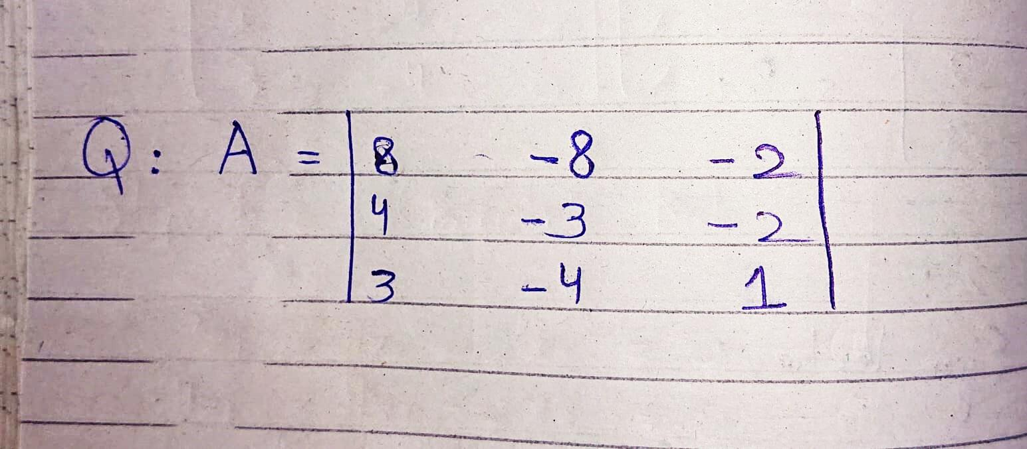
Question:

Slide 5
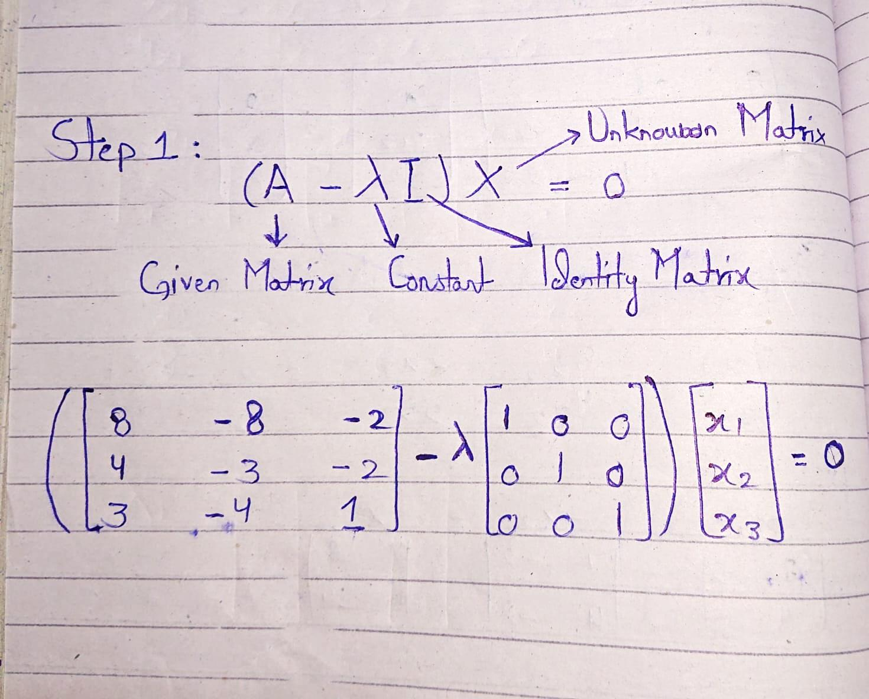
Solve:

Slide 6
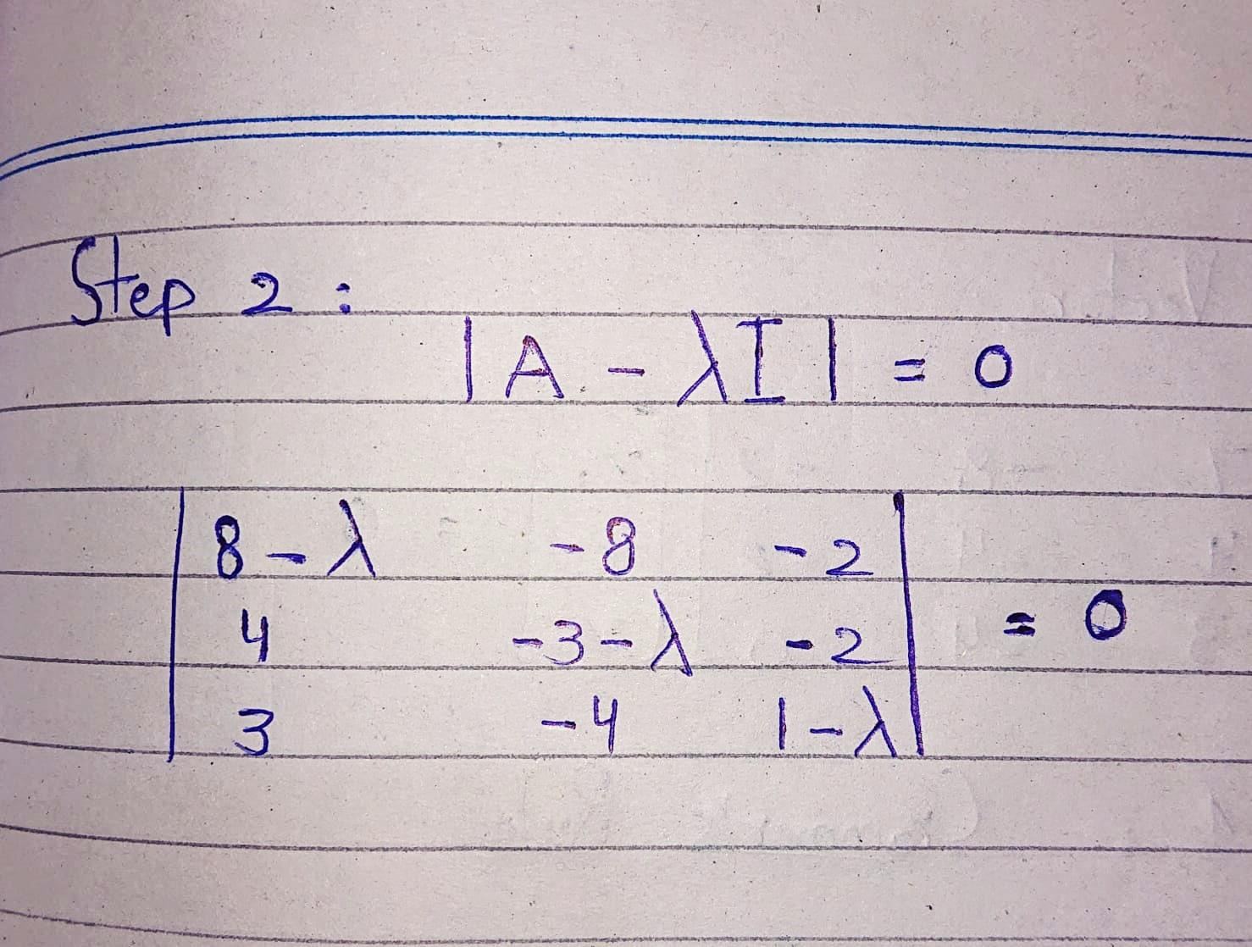

Slide 7
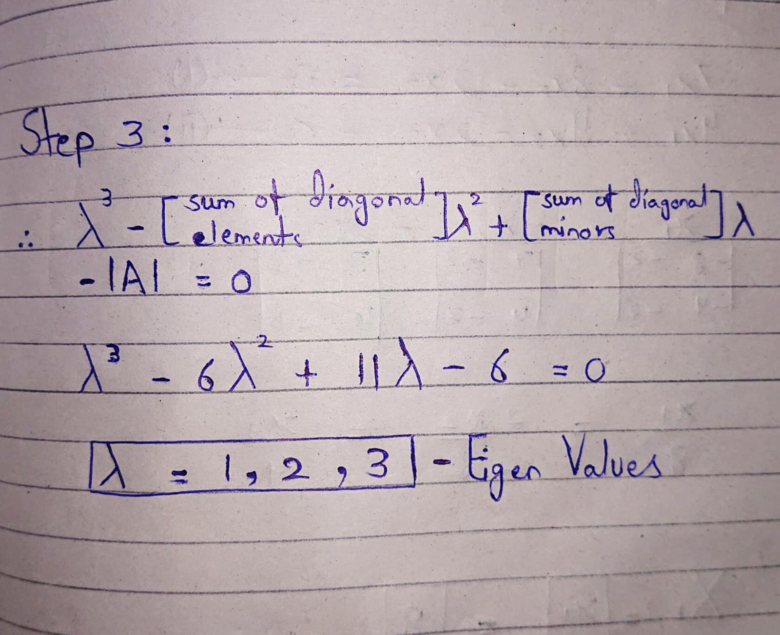

Slide 8
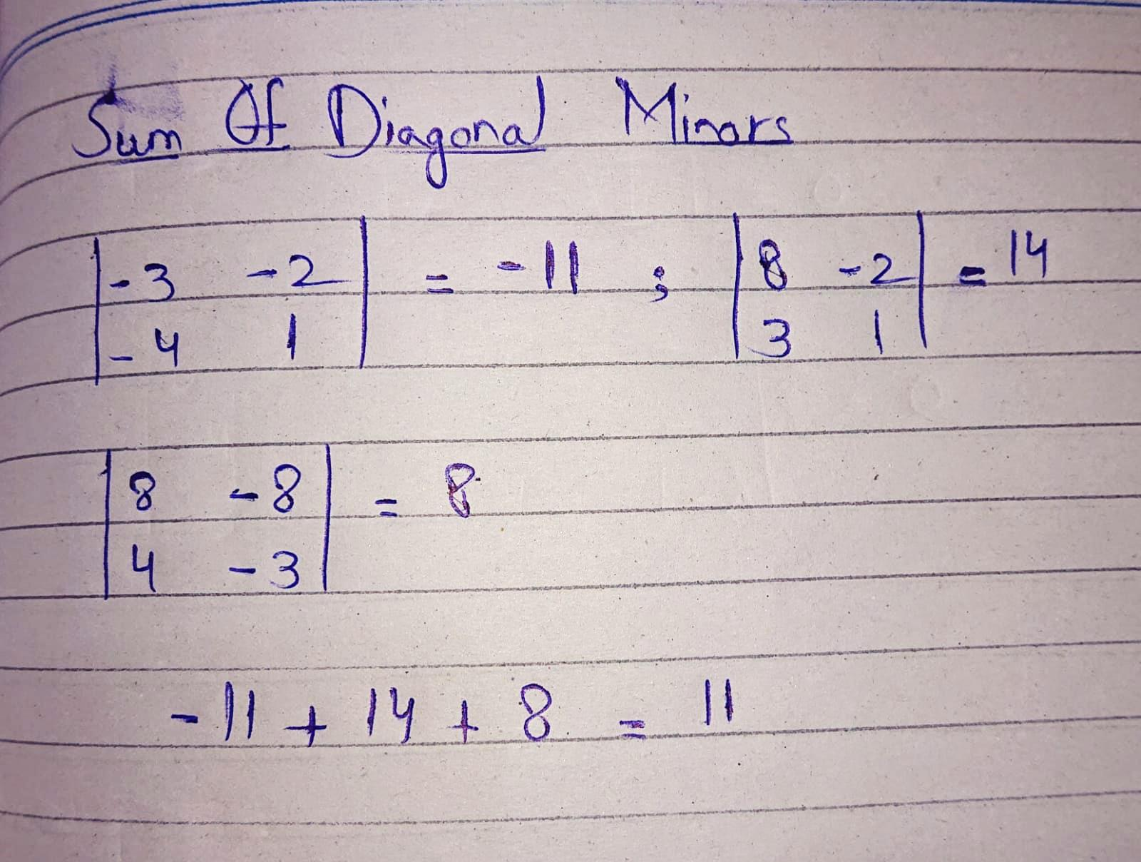

Slide 9
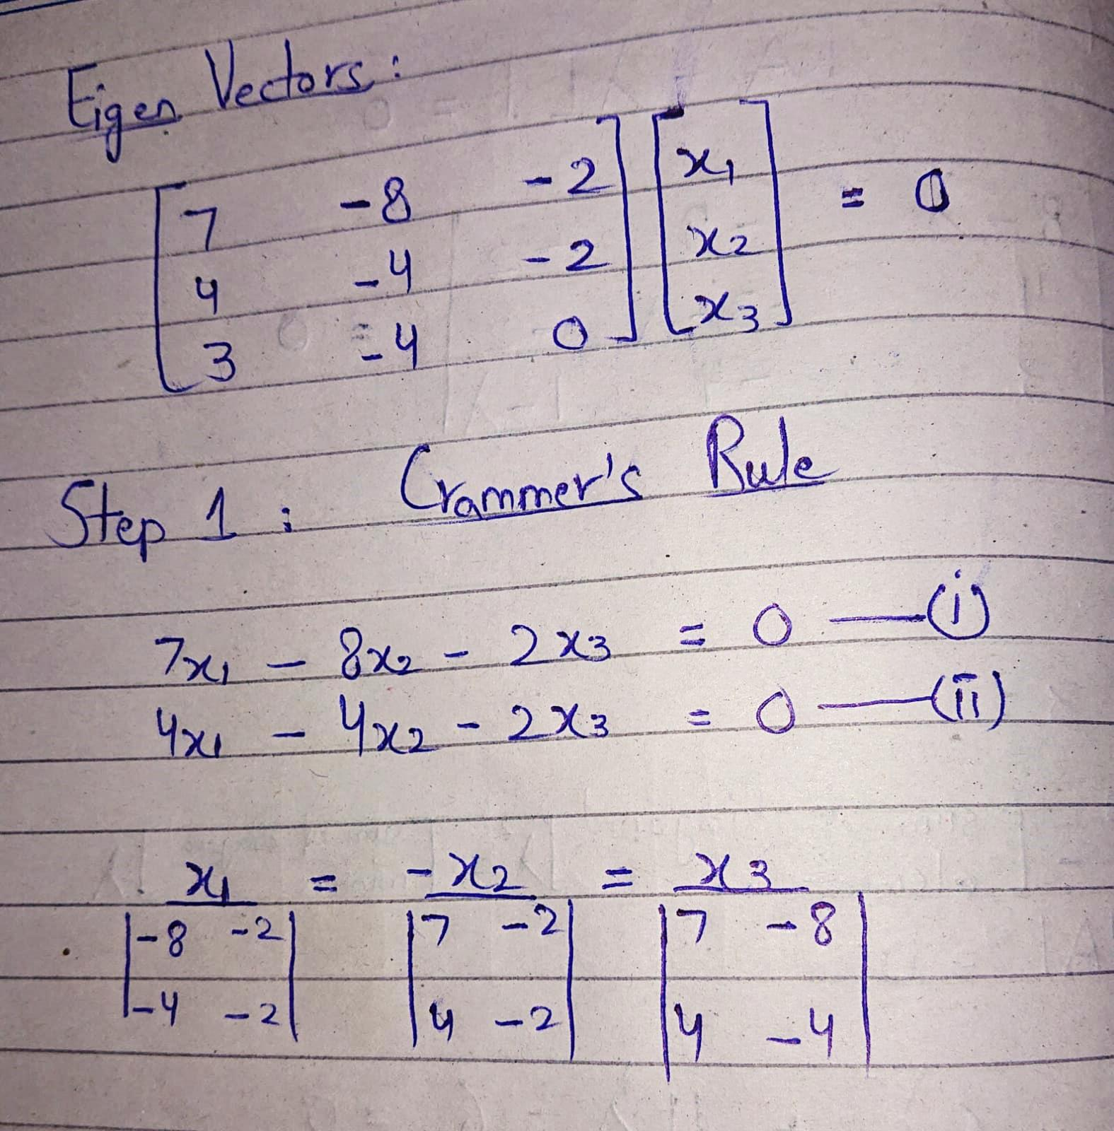

Slide 10
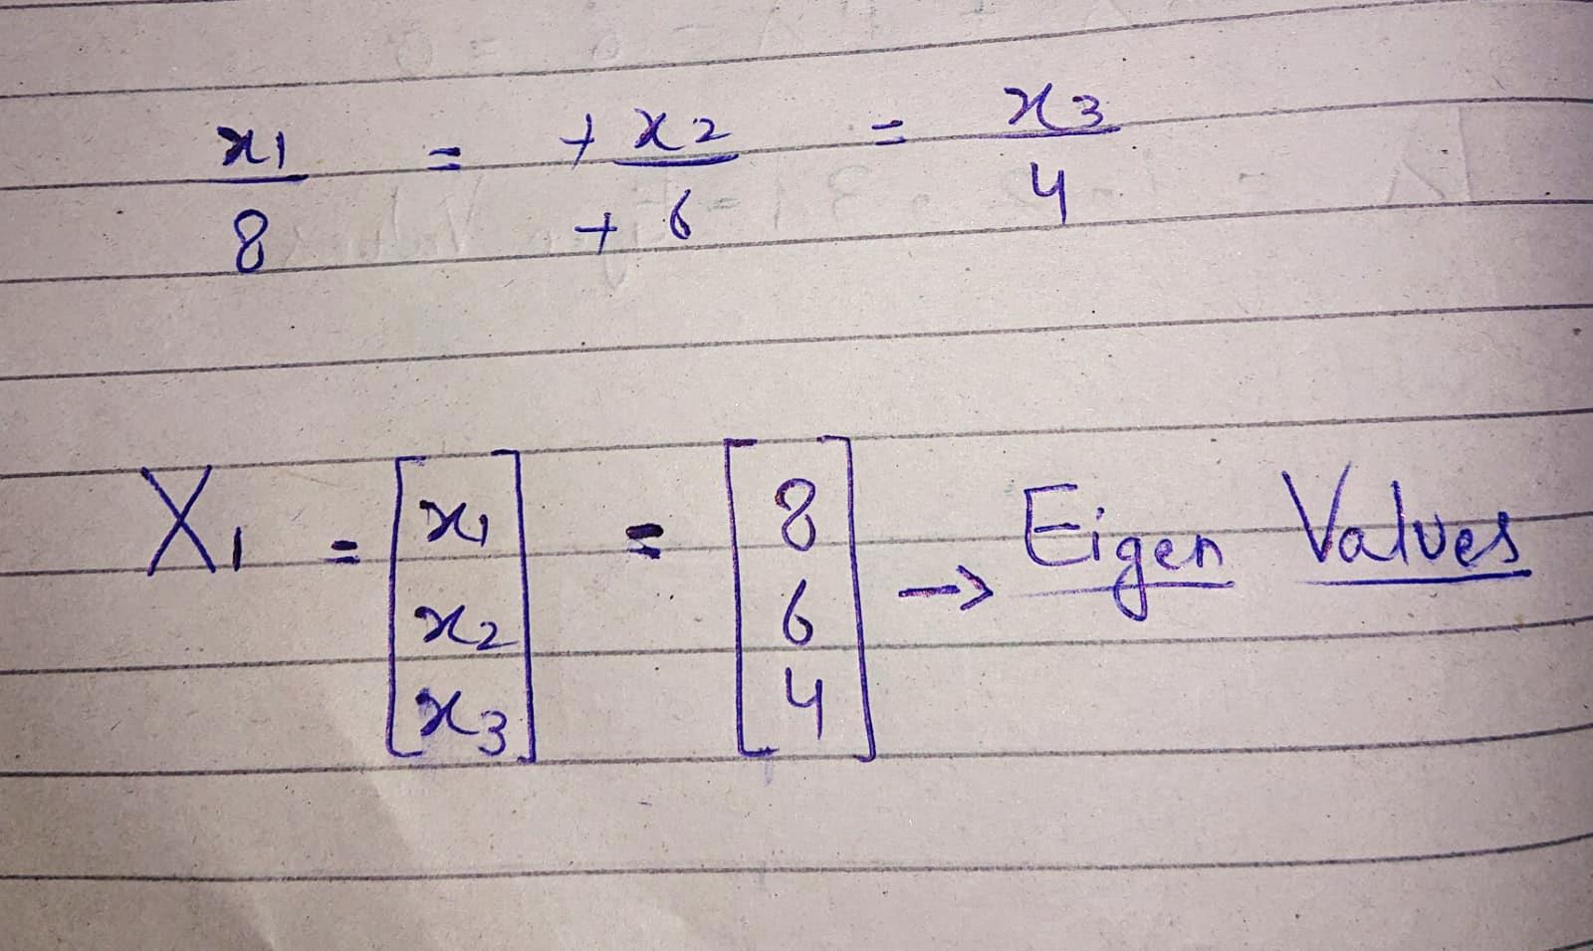
Eigen Vector

Slide 11
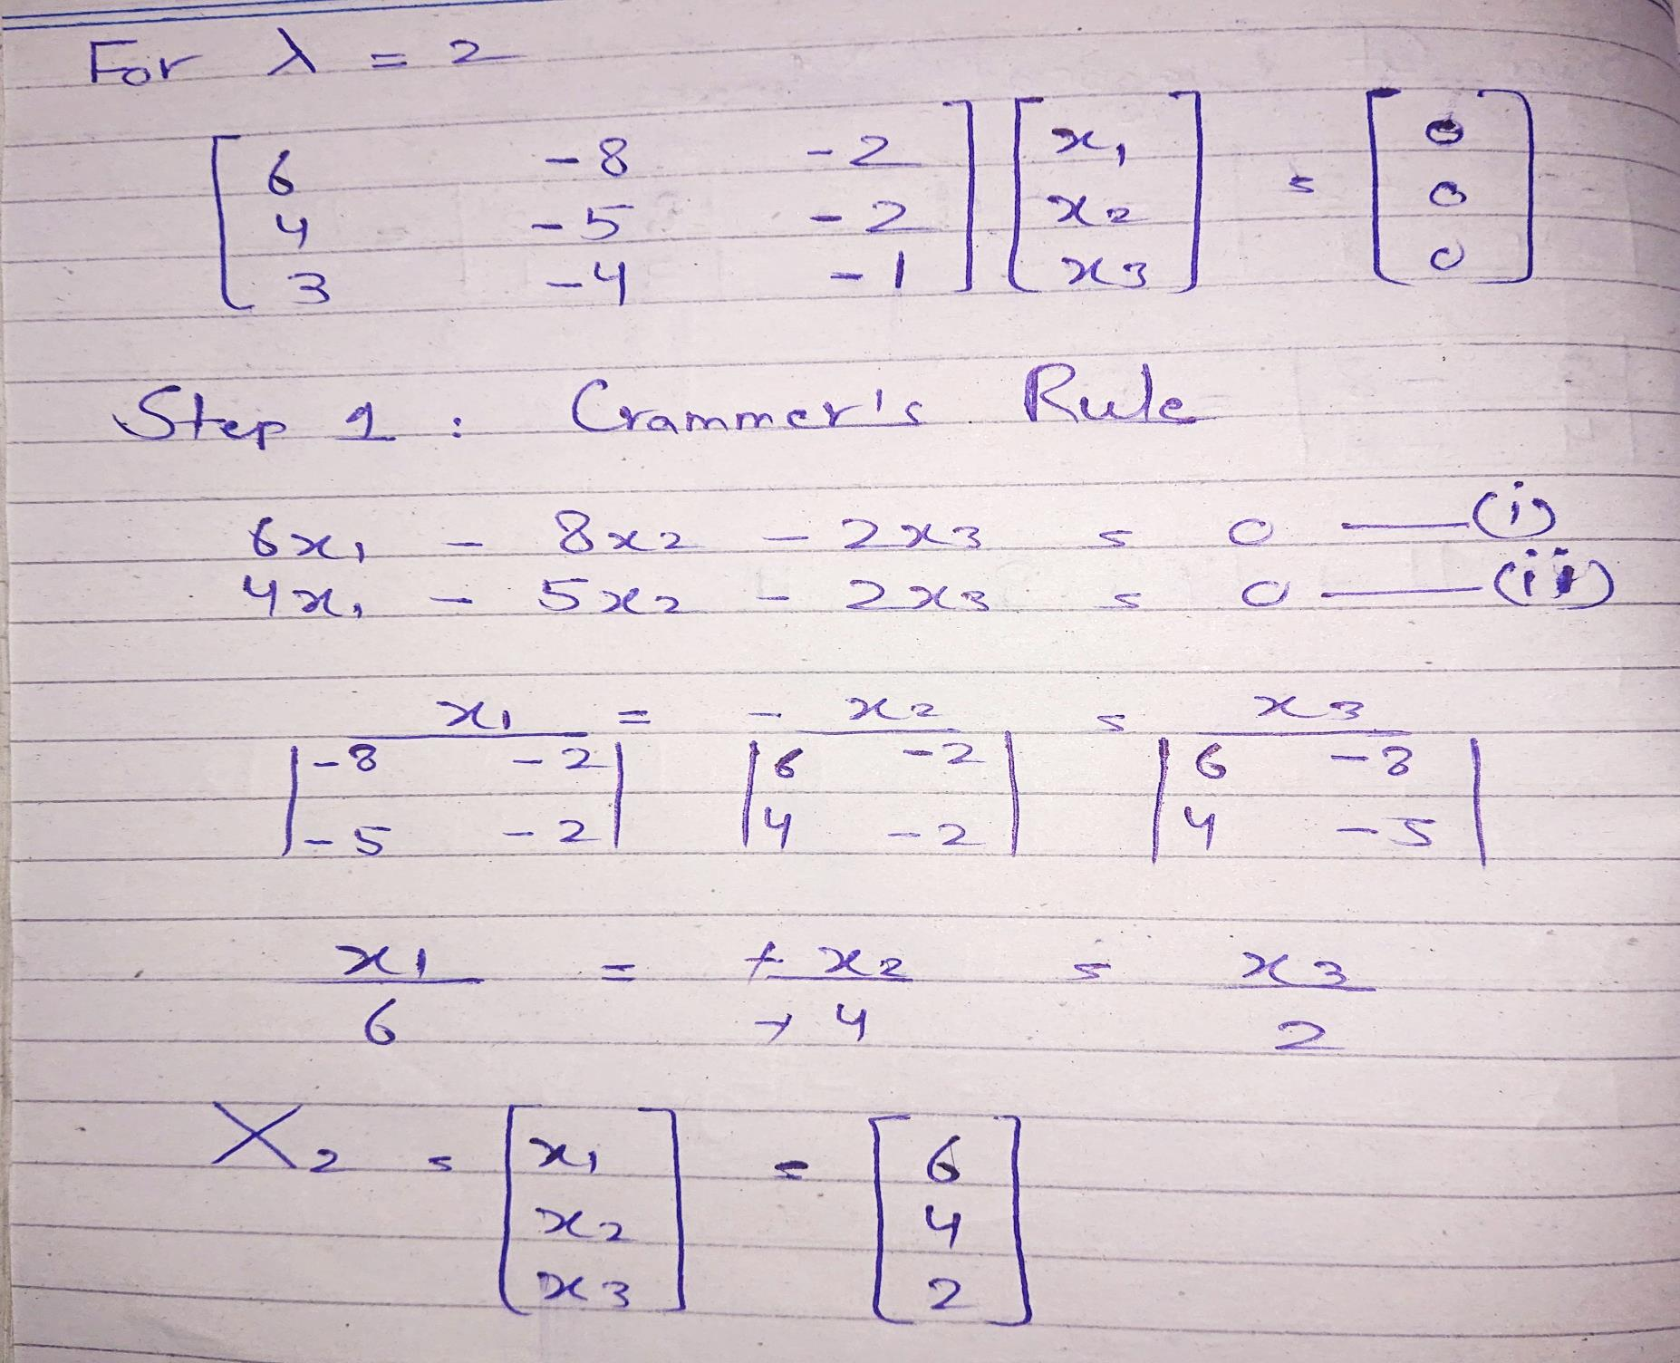

Slide 12
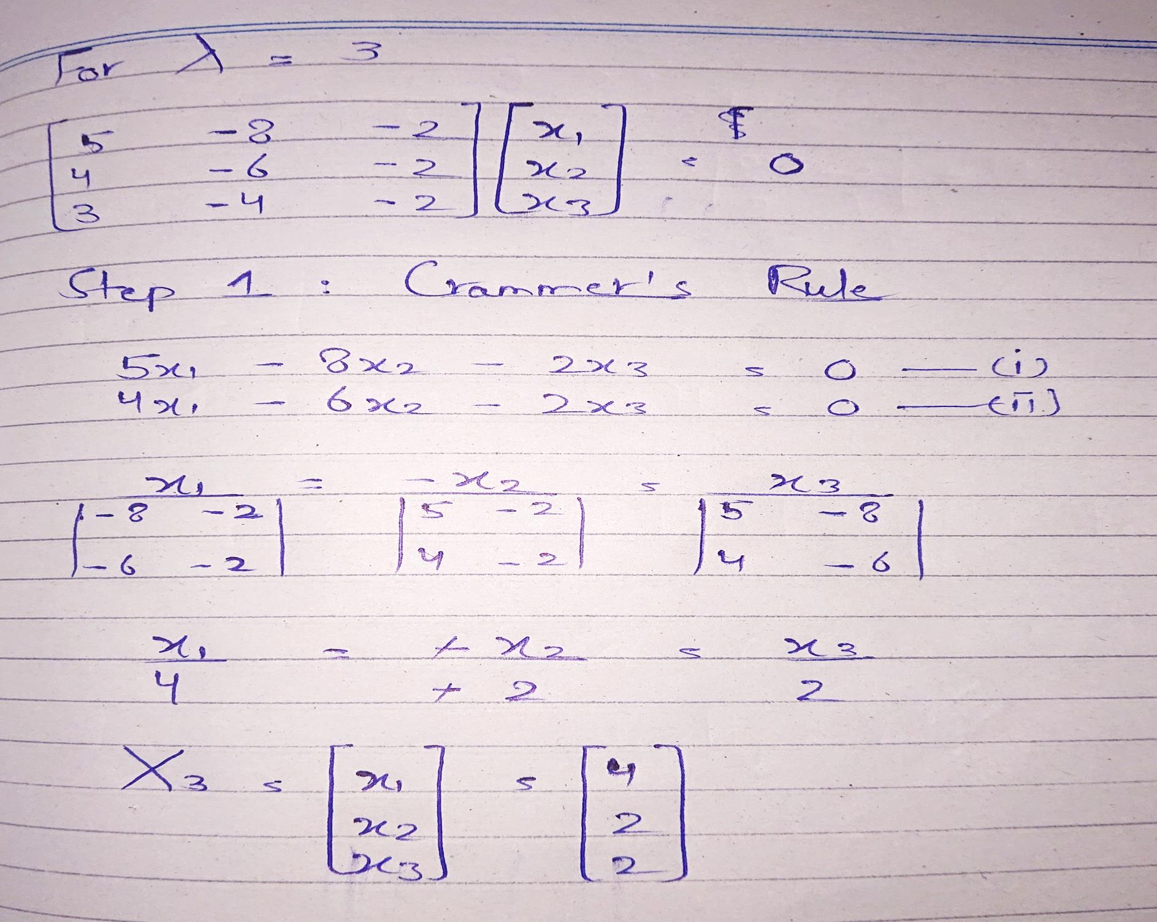

Slide 13
Thank You ☺

